Slide 1
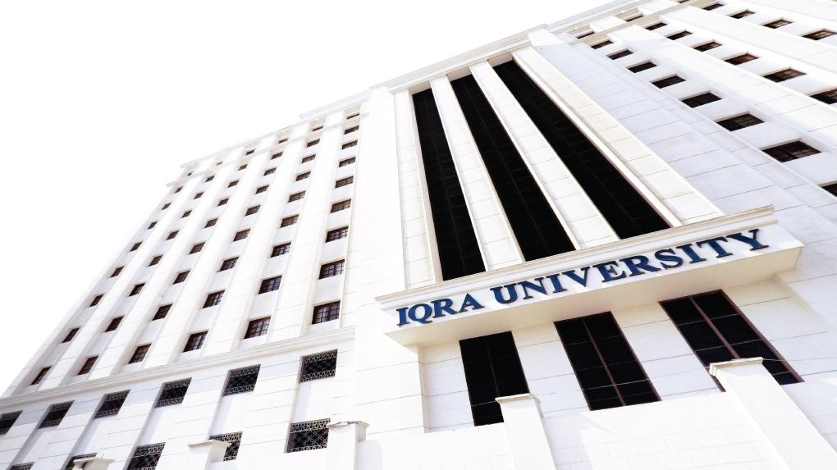

Recurrence Relations (Recursive Representation of Sequences) LECTURE 11
Adapted from :
https://www.genrica.com/vustuff/MTH202/MTH202_handouts_1_45.pdf

Slide 2
Learning Outcomes
After completing this lecture satisfactorily, a student will:
• Be able to construct simple mathematical proofs and possess the ability to
verify them.
Have substantial experience to comprehend formal logical arguments.
• Gain experience in using various techniques of mathematical induction
(weak, strong and structural induction) to prove simple mathematical
properties of a variety of discrete structures.

Slide 3
Recursion
First of all instead of giving the definition of Recursion we give you an example, you already know the Set of Odd numbers Here we give the new definition of the same set that is the set of Odd numbers.
Definition for odd positive integers may be given as:
BASE:
1 is an odd positive integer.
RECURSION:
If k is an odd positive integer, then k + 2 is an odd positive integer.
Now, 1 is an odd positive integer by the definition base.
With k = 1, 1 + 2 = 3, so 3 is an odd positive integer.
With k = 3, 3 + 2 = 5, so 5 is an odd positive integer
and so, 7, 9, 11, … are odd positive integers.
REMARK: Recursive definitions can be used in a “generative” manner.

Slide 4
RECURSION:
The process of defining an object in terms of smaller versions of itself is called recursion.
A recursive definition has two parts:
1.BASE:
An initial simple definition which cannot be expressed in terms of smaller versions of itself.
2. RECURSION:
The part of definition which can be expressed in terms of smaller versions of itself.
RECURSIVELY DEFINED FUNCTIONS:
A function is said to be recursively defined if the function refers to itself such that
1. There are certain arguments, called base values, for which the function does not refer to itself.
2. Each time the function does refer to itself, the argument of the function must be closer to a
base value.

Slide 5
EXAMPLE:
Suppose that f is defined recursively by
f(0) = 3
f(n + 1) = 2 f (n) + 3
Find f(1), f(2), f(3) and f(4)
SOLUTION:
From the recursive definition it follows that
f(1) = 2 f(0) + 3 = 2(3) + 3 = 6 + 3 = 9
In evaluating of f(1) we use the formula given in the example and we note that it involves f(0) and we are also given the value of that which we use to find out the functional value at 1. Similarly we will use the preceding value
In evaluating the next values of the functions as we did below.
f(2) = 2 f(1) + 3 = 2(9) + 3 = 18 + 3 = 21
f(3) = 2 f(2) + 3 = 2(21) + 3 = 42 + 3 = 45
f(4) = 2 f(3) + 3 = 2(45) + 3 = 90 + 3 = 93

Slide 6
EXERCISE:
Find f(2) and f(3), if f is defined recursively by
f(0) = -1, f(1)=2 and for n = 1, 2, 3, …
f(n+1) = f(n) + 3 f(n - 1)
SOLUTION:
From the recursive definition it follows that
f(2) = f(1) + 3 f (1-1)
= f(1) + 3 f (0)
= 2 + 3 (-1)
= -1
Now in order to find out the other values we will need the values of the preceding .So we write these values here again
f(0) = -1, f(1)=2 f(n+1) = f(n) + 3 f(n - 1)
f(2) = -1
By recursive formula we have
f(3) = f(2) + 3 f (2-1)
= f(2) + 3 f (1)
= (-1) + 3 (2)
= 5

Slide 7
THE FACTORIAL OF A POSITIVE INTEGER:
For each positive integer n, the factorial of n denoted n! is defined to be the product of all the integers from 1 to n:
n! = n·(n - 1)·(n - 2) · · · 3 · 2 · 1
Zero factorial is defined to be 1
0! = 1
EXAMPLE:
0! = 1 1! = 1
2! = 2·1 = 2 3! = 3·2·1 = 6
4! = 4·3·2·1 = 24 5! = 5·4·3·2·1 = 120
6! = 6·5·4·3·2·1= 720 7! = 7·6·5·4·3·2·1= 5040
REMARK:
5! = 5 · 4 · 3 · 2 · 1
= 5 ·(4 · 3 · 2 · 1)
= 5 · 4!
In general,
n! = n(n-1)! for each positive integer n.

Slide 8
THE FACTORIAL FUNCTION DEFINED RECURSIVELY:
We can define the factorial function F(n) = n! recursively by specifying the initial value of this function, namely, F(0) = 1, and giving a rule for finding F(n) from
F(n-1).{(n! = n(n-1)!}
Thus, the recursive definition of factorial function F(n) is:
1. F(0) = 1
2. F(n) = n F(n-1)
EXERCISE:
Let S be the function such that S(n) is the sum of the first n positive integers. Give a recursive definition of S(n).
SOLUTION:
The initial value of this function may be specified as S(0) = 0
Since
S(n) = n + (n - 1) + (n - 2) + … + 3 + 2 + 1
= n + [(n - 1) + (n - 2) + … + 3 + 2 + 1]
= n + S(n-1)
which defines the recursive step.
Accordingly S may be defined as:
1. S(0)= 0
2. S(n) = n + S(n - 1) for n ≥ 1

Slide 10
THE FIBONACCI SEQUENCE:
The Fibonacci sequence is defined as follows. F₀ = 1, F₁ = 1 F_{k} = F_{k-1} + F_{k-2} for all integers k ≥ 2
F₂ = F₁ + F₀ = 1 + 1 = 2 F₃ = F₂ + F₁ = 2 + 1 = 3 F₄ = F₃ + F₂ = 3 + 2 = 5 F₅ = F₄ + F₃ = 5 + 3 = 8
RECURRENCE RELATION:
A recurrence relation for a sequence a₀, a₁, a₂, . . . , is a formula that relates each term a_{k} to certain of its predecessors a_{k-1}, a_{k-2}, . . . , a_{k-i} ,
where i is a fixed integer and k is any integer greater than or equal to i. The initial conditions for such a recurrence relation specify the values of a₀, a₁, a₂, . . . , a_{i-1}.

Slide 11
EXERCISE:
Find the first four terms of the following recursively defined sequence.
b₁ = 2
b_{k} = b_{k-1} + 2 · k, for all integers k ≥ 2
SOLUTION:
b₁ = 2 (given in base step)
b₂ = b₁ + 2 · 2 = 2 + 4 = 6
b₃ = b₂ + 2 · 3 = 6 + 6 = 12
b₄ = b₃ + 2 · 4 = 12 + 8 = 20
EXERCISE:
Find the first five terms of the following recursively defined sequence.
t₀ = – 1, t₁ = 1
t_{k} = t_{k-1} + 2 · t_{k-2}, for all integers k ≥ 2
SOLUTION:
t₀ = – 1, (given in base step)
t₁ = 1 (given in base step)
t₂ = t₁ + 2 · t₀ = 1 + 2 · (–1) = 1 – 2 = –1
t₃ = t₂ + 2 · t₁ = –1 + 2 · 1 = –1 + 2 = 1
t₄ = t3 + 2 · t₂ = 1 + 2 · (–1) = 1 – 2 = –1

Slide 12
EXERCISE:
Define a sequence b₀, b₁, b₂, . . . by the formula
bn = 5 ^{n} , for all integers n ≥ 0.
Show that this sequence satisfies the recurrence relation b_{k} = 5b_{k} – 1, for all integers
k ≥ 1.
SOLUTION:
The sequence is given by the formula
bn = 5 ^{n}
Substituting k for n we get
b_{k} = 5^{k} . . . . . (1)
Substituting k – 1 for n we get
b_{k-1} = 5 ^{k-1} . . . . . (2)
Multiplying both sides of (2) by 5 we obtain
5 · b_{k-1} = 5 · 5^{k} – 1
= 5^{k} = b_{k} using (1)
Hence b_{k} = 5b_{k-1} as required

Slide 13
Review Questions
What is Recurrence relation
Define recursive defined functions

Slide 14
Thank you
Insert the title of your subtitle Here

